Slide 1
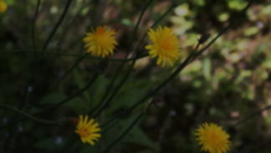
Herbivore damage in native and invasive Taraxacum spp. in Churchill
Vicki M. Zhang
April 29, 2020
EEB1455
Image from T. K. Lim

Slide 2
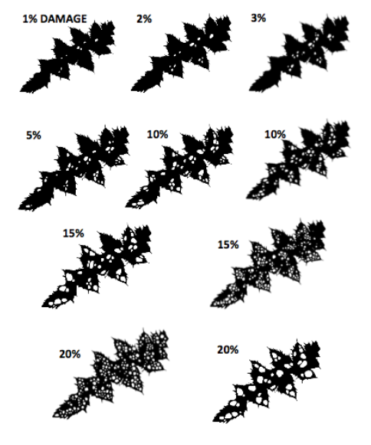
Herbivore damage
Plant species experience less herbivore damage in higher latitudes
Less invaders in northern environments
Data set (P. Kotanen, 2018)
2 dandelion species: T. lacerum (native) and T. officinale (invasive)
5 sites that ranged from disturbed to undisturbed
3 measures of herbivory per individual (leaves)
Notes:
Non-native species can invade habitats that they are not naturally found in. This sort of exotic species invasion is common throughout temperate zones & is a major cause of native biodiversity loss and global change.
However, northern environments are almost free of invasive plants. This may be due to a number of reasons, such as poorer plant performance and defense against herbivores in the unsuitable environmental conditions.
The data set that I used is from my supervisor, Peter Kotanen. In 2018, Peter sampled vertebrate and insect herbivory of several dandelion species in Churchill, Manitoba. Churchill has several invaders within the town, but almost none of these invaders have spread from the town into the surrounding boreal forest or tundra; in this way, invaders may do better in the inhabited, disturbed town than the undisturbed surroundings outside of town. Peter collected herbivory damage as a percent from two species of dandelion, a native and an invader. Herbivore damage was collected from 5 sites that ranged from disturbed (within Churchill) to undisturbed (further away from Churchill). The herbivory damage measurements were taken of on the 3 largest leaves (presumably the oldest). Aim: model herbivore damage of the two species at 5 sites.

Slide 3
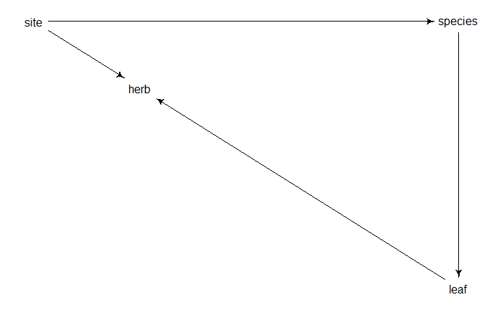
DAG
fixed effect
blocked variable
fixed effect
blocked variable
blocked variable
Notes:
Site and species both affect herbivory. Different sites will have different levels of herbivory.
Species will also affect herbivory but through a backdoor path of leaf #. We have 2 dandelion species here, and it is hypothesized that the invasive species will face greater levels of herbivory. However, there is confound created by the leaf that was sampled since not all leaf material are the same, between and within species. This is based on the fact that not all individuals sampled may have been the same size or age (dandelions are perennial) and the leaf morphology differs between the two species.
In my models, I had species as both a fixed and blocked variable, site as a fixed or blocked variable, or removed site from the equation altogether, and had leaf as a blocked variable.

Slide 4
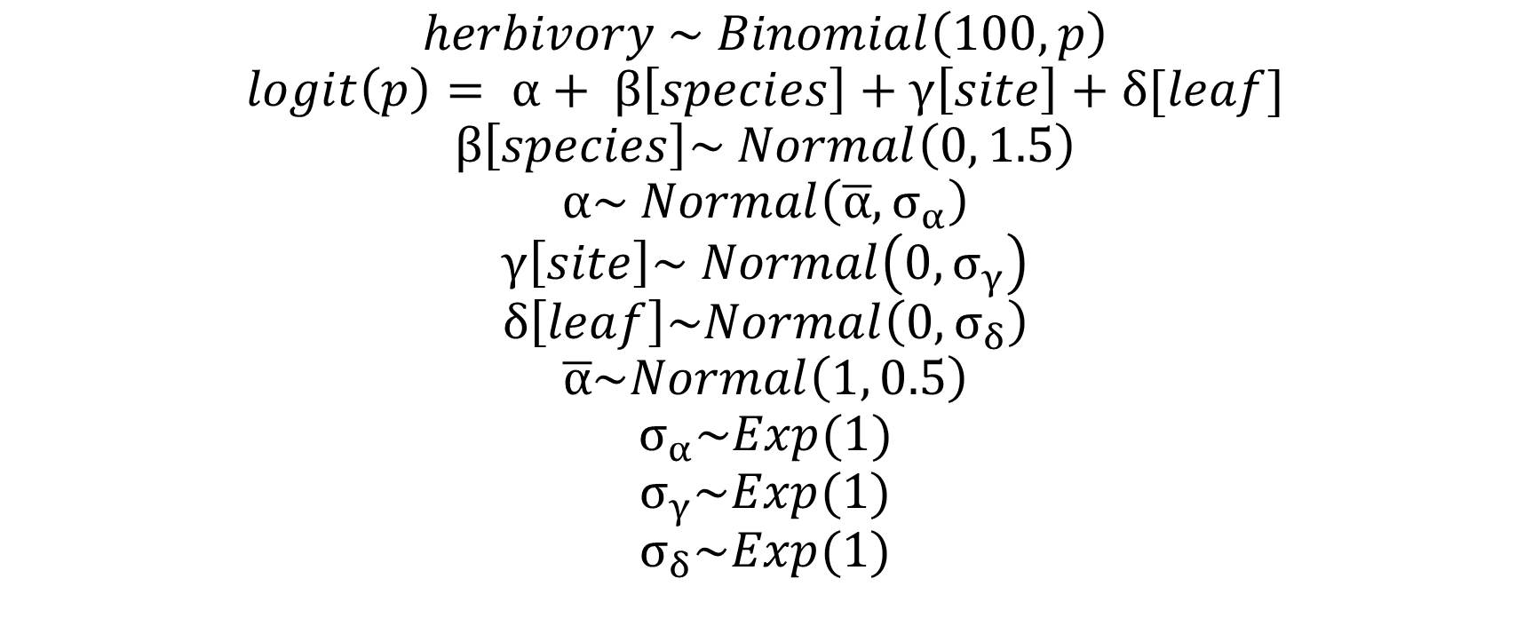
Model
$$herbivory \sim Binomial\left(100, p\right)$$
$$logit\left(p\right)= α+ β\left[species\right]+γ\left[site\right]+δ[leaf]$$
$$β\left[species\right]\sim Normal\left(0, 1.5\right)$$
$$α\sim Normal\left(\overline{α}, σ_{α}\right)$$
$$γ\left[site\right]\sim Normal\left(0, σ_{γ}\right)$$
$$δ\left[leaf\right]\sim Normal\left(0, σ_{δ}\right)$$
$$\overline{α}\sim Normal\left(1, 0.5\right)$$
$$σ_{α}\sim Exp(1)$$
$$σ_{γ}\sim Exp(1)$$
$$σ_{δ}\sim Exp(1)$$
Notes:
This was my most complex model
I have a binomial model, modelling herbivory; n = 100 because herbivory was measured as a percentage.
I have an central alpha intercept, then separate intercepts for species, site and leaf.
For species, I have a weakly informative prior, based on prior predictive simulations
For the other parameters, I have adaptive priors and hyperpriors. Alpha-bar is another weakly informative prior, and the sigmas are all exponential

Slide 5
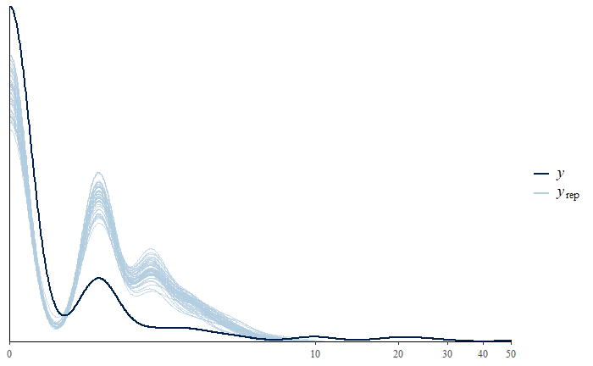
Posterior predictive checks
Underpredicts 0s
~72% individual plants have 0% herbivory
Underpredicts high levels of herbivory
High levels of damage are very rare
Notes:
I did some PPC to check how my model did against raw data. I ran into some issues here using the base R code in the textbook, and Max recommended that I use the bayesplot package, which has been really easy to navigate.
I also ran into some issues with the posterior predictions making bad predictions. About 72% individual plants have 0% herbivory; my first models only captured about 30% of that. That is, the model predicted that about 30% of plants will have no herbivore damage. Instead, most individual plants had about 2% damage. These first models did not capture the data well at all.
In nature, high levels of damage are very rare; still, I want the model to be able to predict the very rare high levels of damage of individuals. This may be important if the individual is an invader that is failing to invade outside of the town footprint – this is useful knowledge

Slide 6
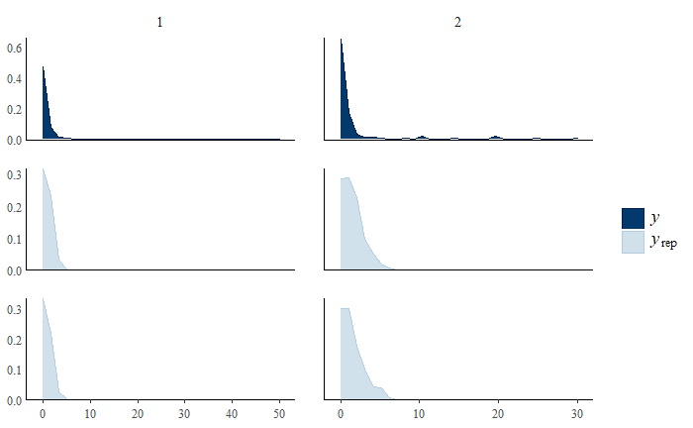
Predictions
Species 1 = native; species 2 = invader
Model predicts that T. officinale has greater herbivore damage
Notes:
Still fails to predict high levels of herbivory, but perhaps this is evidence that the model is not overfitting
However, this model does confirm our suspicions that invaders face higher levels of herbivore damage, perhaps alluding to the fact that invaders do not succeed in the north as easily as they do in temperate zones

Slide 7
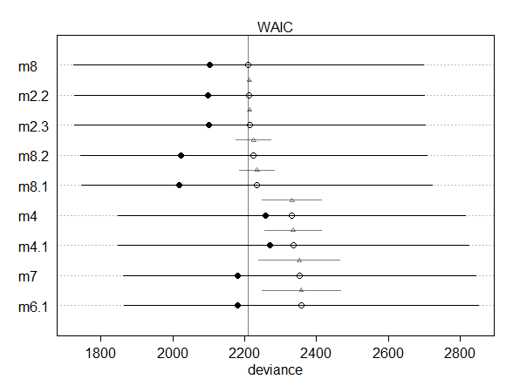
Model Comparisons
The most complex models are m8 & m8.1 (with different priors)
However, models 2.2 & 2.3 have similar WAICs
Not MLM
`leaf` as variable instead of `site`
Notes:
Open dots = WAIC

Slide 8
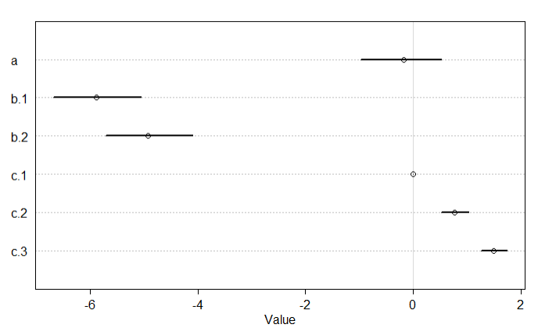
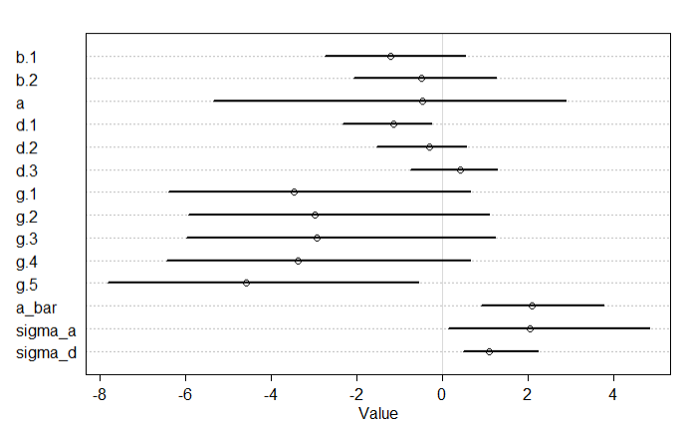
Model Comparisons
m2.2: No site parameter
Native species (b1) -> negative influence on herbivore damage
Leaf (c) -> positive effect
m8: MLM with all parameters
Site (g) had similar negative effects
Leaf (d) had different effects
Notes:
Here are the precis outputs. There is evidence that the leaf that the herbivory measure was taken on is an important parameter to include. However, herbivore differences based on site are not as implicated; these differences may be captured in other variables, such as `species`, since different species are found in different sites.

Slide 9

Thanks!
churchillscience.com

